Slide 1
深度学习论文指南
刘子瑛

Slide 2
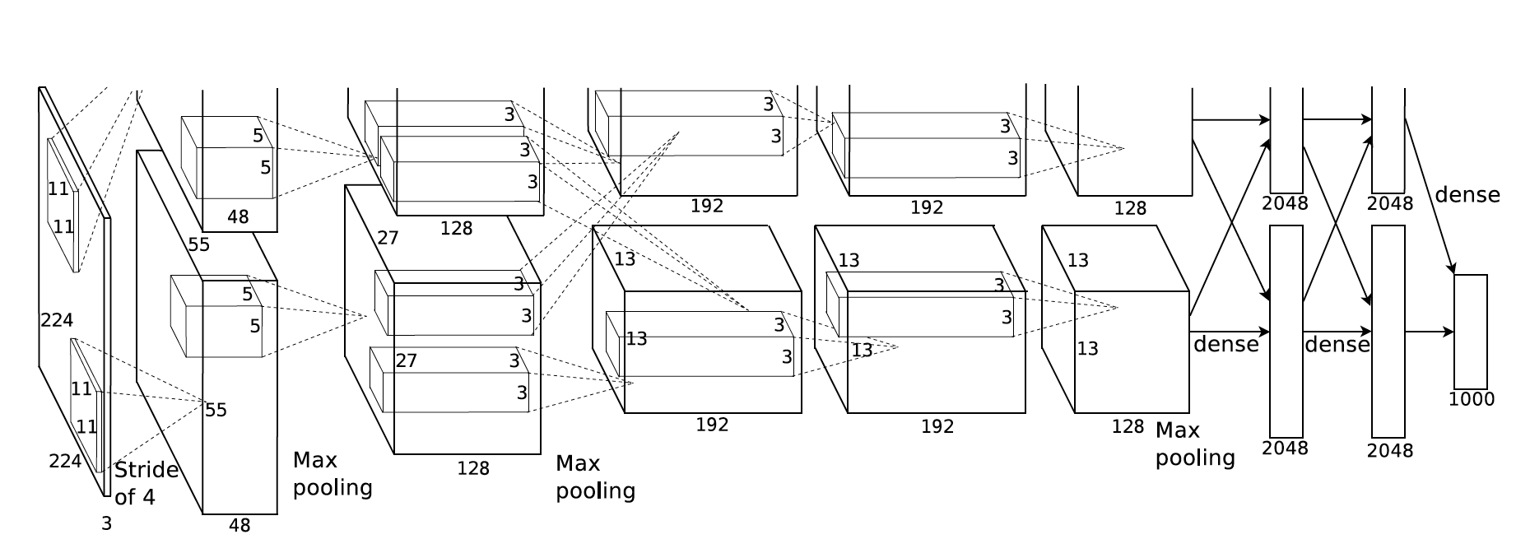
AlexNet：2012
ImageNet Classification with Deep Convolutional Neural Networks

Slide 3
Alexnet的结构
输入：224*224*3 = 150528
第一层：11*11卷积核，步幅4，96核，
第二层：5*5卷积核，256核，输出：27*27*256
第三层：3*3，384核，输出：13*13*384
第四层：3*3，384核，输出：13*13*384
第五层：3*3，256核，输出：13*13*256
第六层：4096全连接
第七层：4096全连接
第八层：1000 softmax

Slide 4
VGGNet
VERY DEEP CONVOLUTIONAL NETWORKS FOR LARGE-SCALE IMAGE RECOGNITION

Slide 5
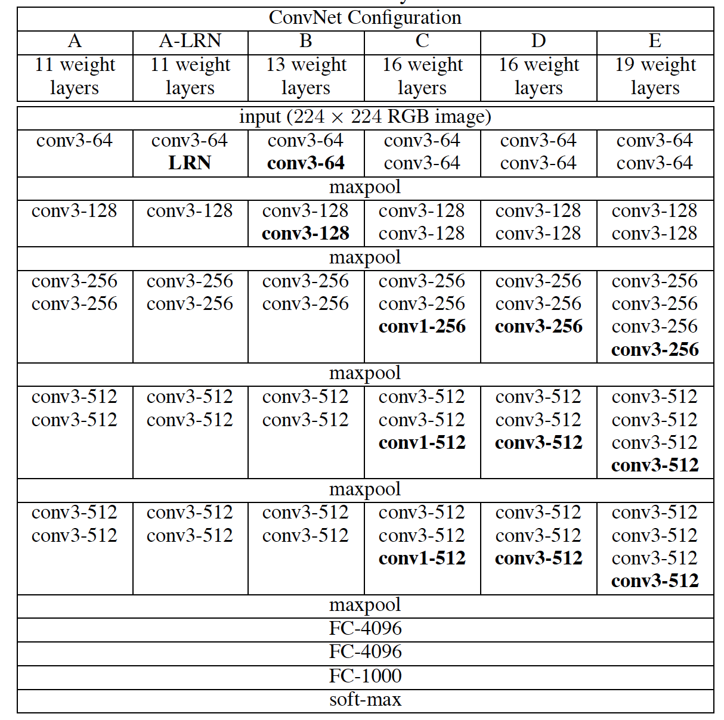
VGGNet网络结构

Slide 6
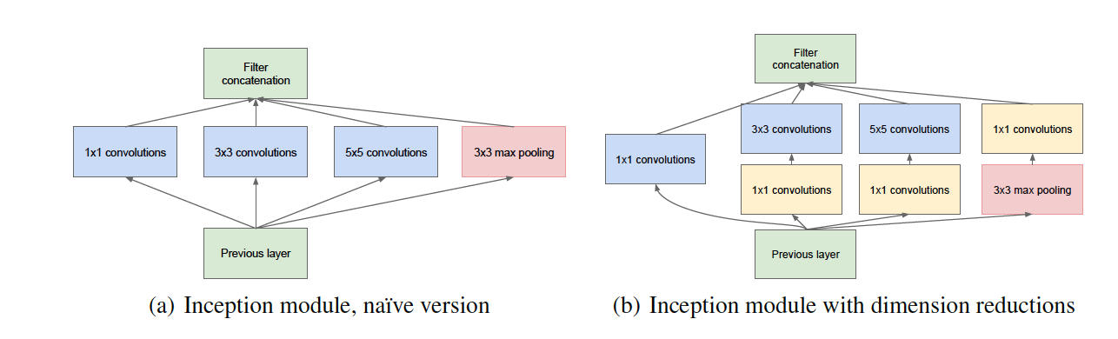
Inception v1: module

Slide 7
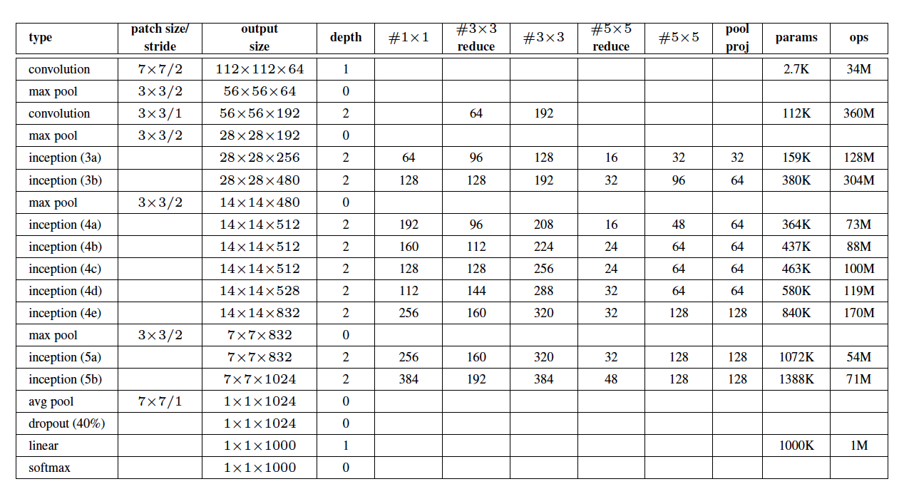
Googlenet结构

Slide 8
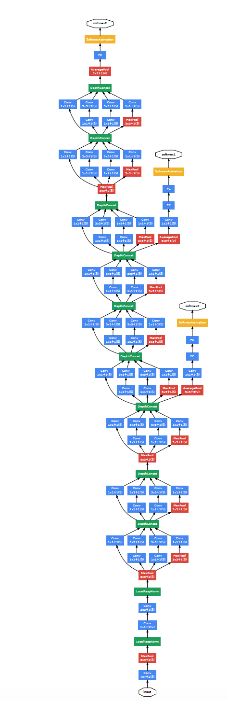
Inception v1全图

Slide 9
resnet
Deep Residual Learning for Image Recognition

Slide 10
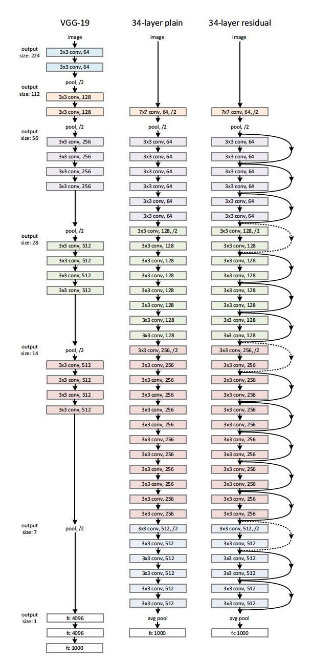
Resnet结构

Slide 11
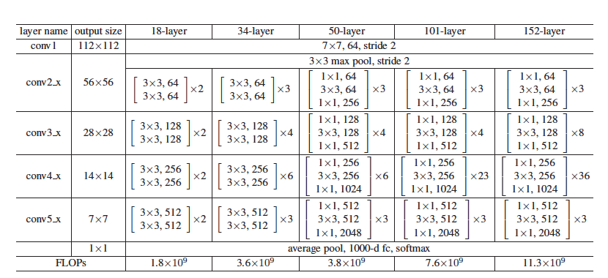
Resnet结构表

Slide 12
Densenet
Densely Connected Convolutional Networks

Slide 13
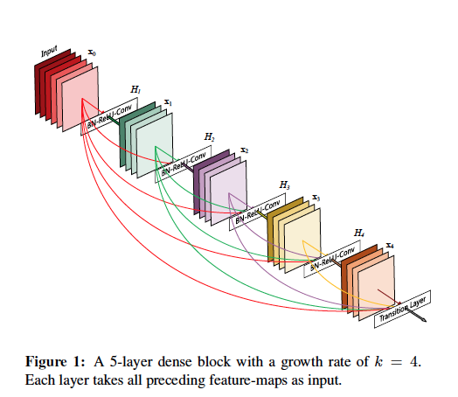
Dense block

Slide 14
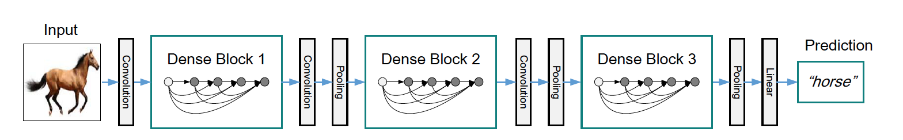
Densenet

Slide 15
resnext
Aggregated Residual Transformations for Deep Neural Networks

Slide 16
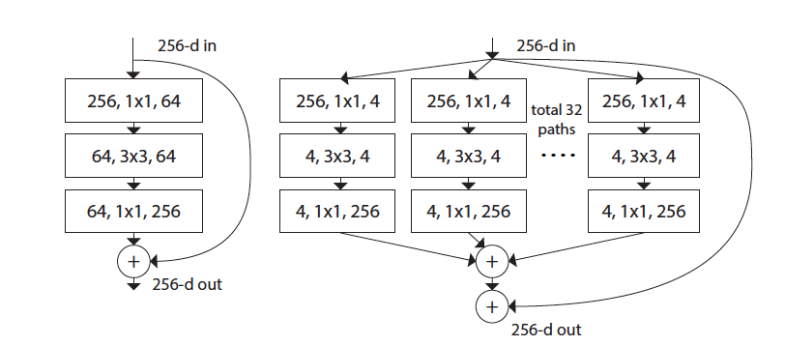
Resnext与resnet结构对比

Slide 17
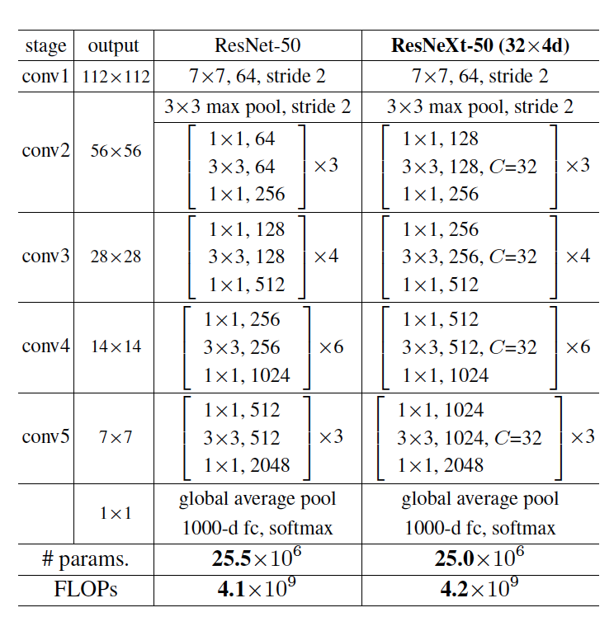
Resnext与resnet网络结构对比

Slide 18
Dual path network
Dual Path Networks

Slide 19
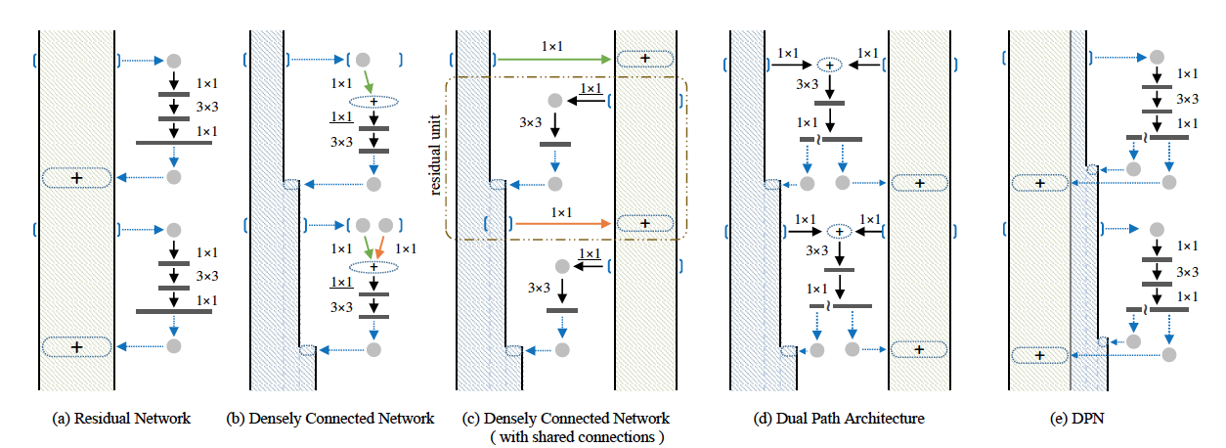
dpnet

Slide 20
R-CNN
Rich feature hierarchies for accurate object detection and semantic segmentation
R-CNN: Region-CNN

Slide 21
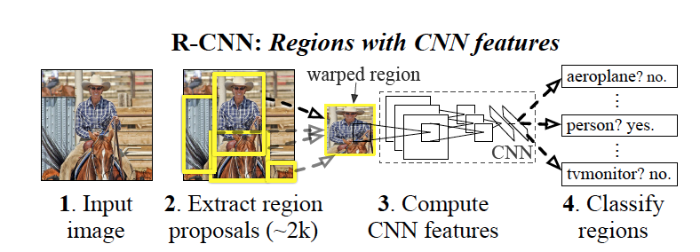
R-CNN识别过程

Slide 22
SPPnet
Spatial Pyramid Pooling in Deep Convolutional Networks for Visual Recognition

Slide 23
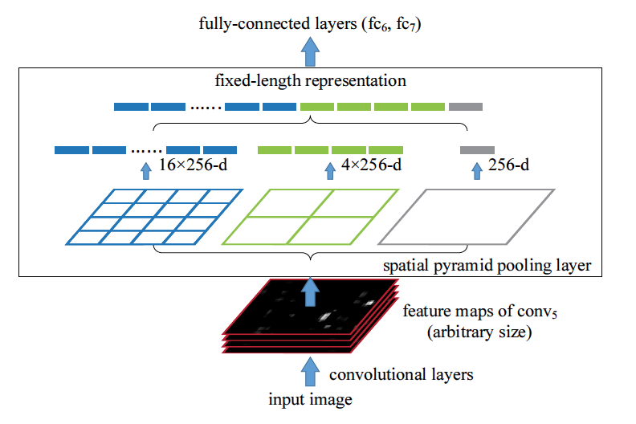
Sppnet结构

Slide 24
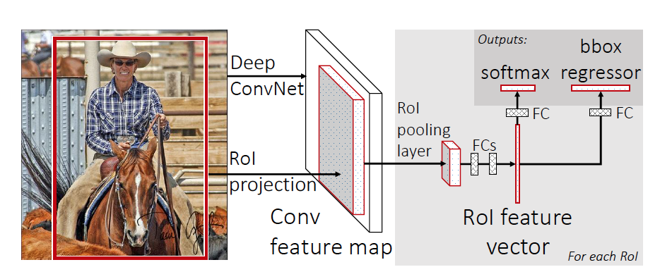
Fast R-CNN

Slide 25
Faster R-CNN
Faster R-CNN: Towards Real-Time Object Detection with Region Proposal Networks

Slide 26
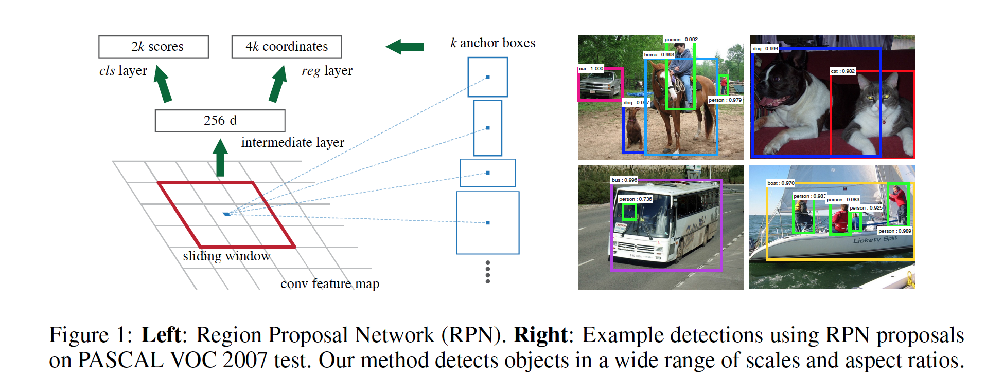
RPN的原理与实例

Slide 27
YOLO
You Only Look Once: Unified, Real-Time Object Detection

Slide 28
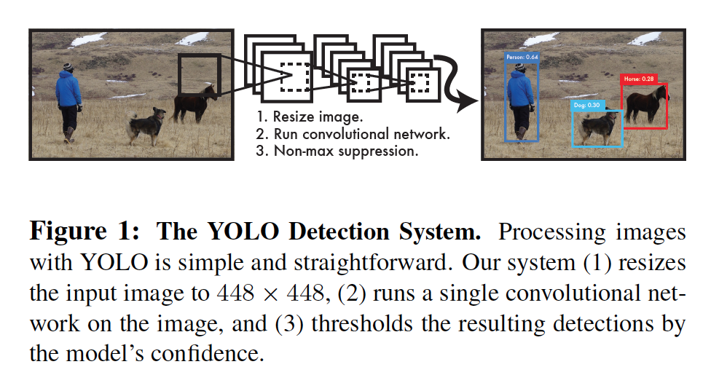
YOLO结构图

Slide 29
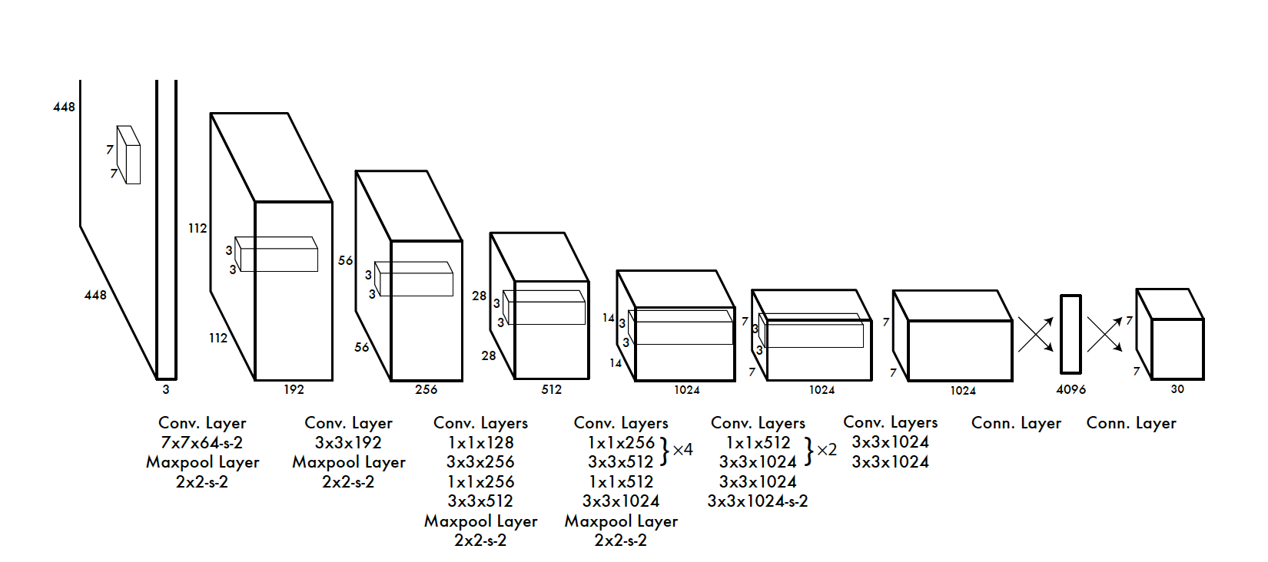
YOLO的实现

Slide 30
SSD
SSD: Single Shot MultiBox Detector

Slide 31
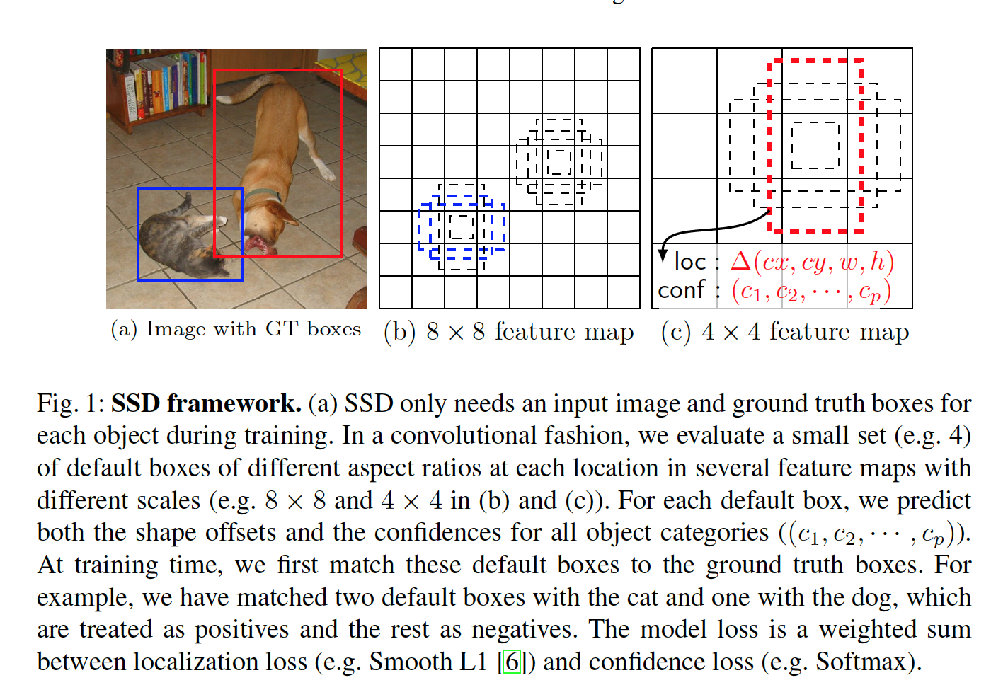
SSD原理

Slide 32
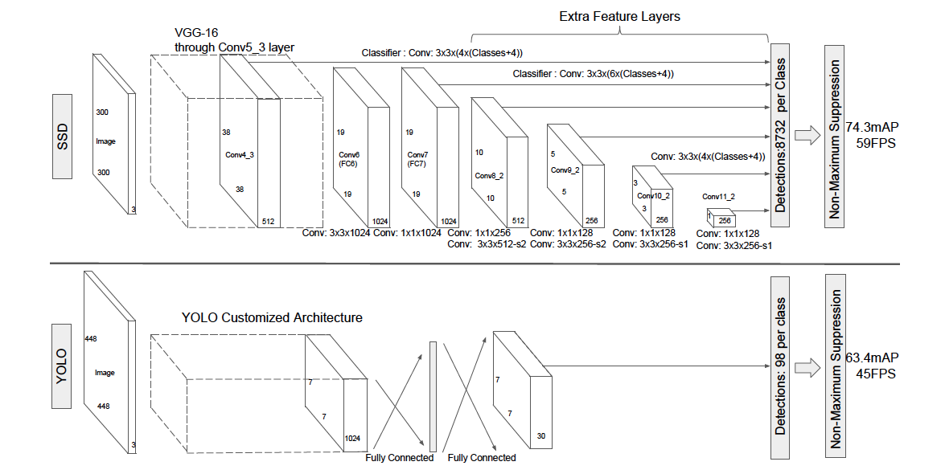
SSD与YOLO结构对比

Slide 33
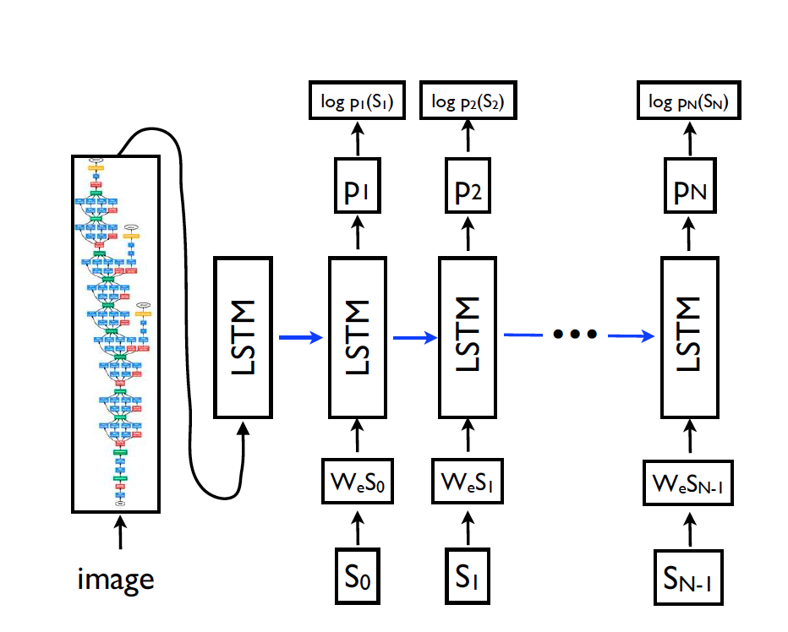
Show and tell
Show and Tell: A Neural Image Caption Generator

Slide 34
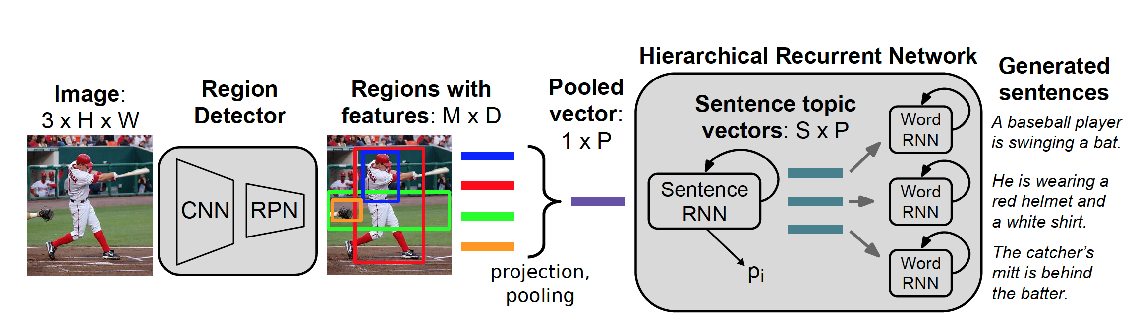
Hierarchical RNN
A Hierarchical Approach for Generating Descriptive Image Paragraphs

